Slide 1
SmartRoad Sensors
Leandra Menezes
NUID: 001621189
Weekday TA: Kedar Deshmukh

Slide 2
Problem Statement
Road accidents is one of the most important causes of death globally.
According to WHO more than 150,000 people will be killed on the roads by 2020, since cars will be more in numbers in developing countries, increasing the number of vehicles on the world´s roads up to 2 billion.
In order to avoid this a lot of companies are focusing on using sensors in cars and roads.
Smart sensors are in trend and it has easily grabbed everyone’s attention. Installing a sensor helps to manage traffic.
As a result it becomes easier to route the car to a different direction with lesser traffic.
Smart sensors on cars can help to only some extent, if it is connected with sensors on the road smarter traffic management can come in place.
Along with traffic management, these sensors can also help to determine weather conditions, safe conditions of the road which will in turn make the road smart.
Companies like Cisco and IBM have started working on these sensors but are still in development phase.

Slide 3
Proposed Solution
Smart Road using Internet of Things works by installing sensors on the road.
Sensors on the road help in easy management of traffic by cameras placed on the road and determining the weather conditions through sensors.
These sensors monitor the congestion on the road and wirelessly send this information to Traffic Control Authority
Smart road sensors can also help determine road conditions as to whether it requires maintenance or repairing by sending the status of the road conditions to the Road Maintenance Authority
SmartRoad Sensors can detect sensor status and request sensor supplier for replacement.

Slide 4
Assumptions
Road Created by the road maintainer is same as the road name sensor data .
Sensor is assumed to give appropriate data.
Traffic Control Authority is assumed to be logged into the system and check data regularly.

Slide 5
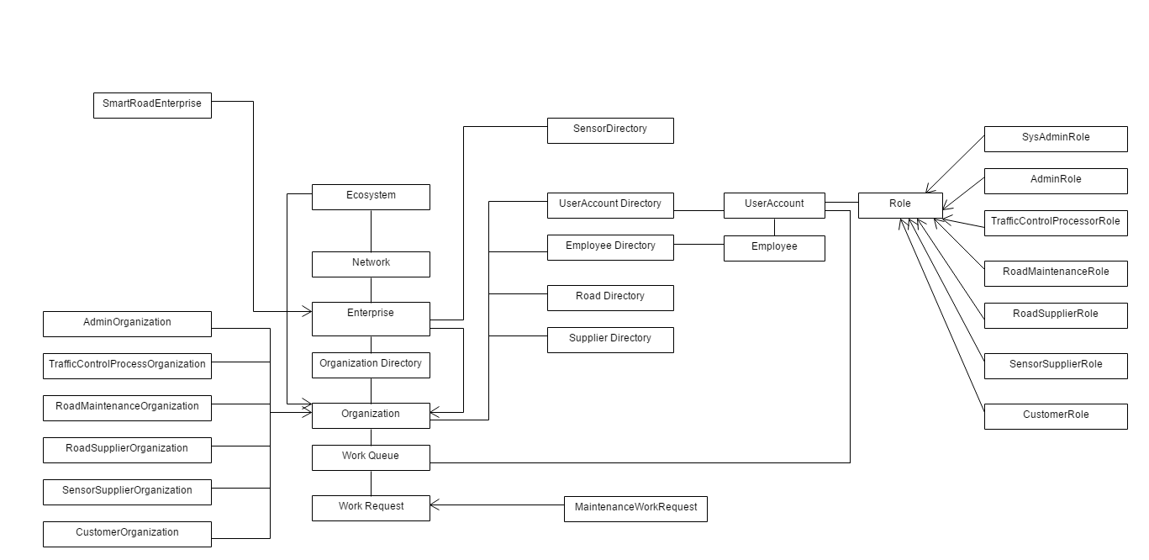
Object Model

Slide 6
Key Roles
System Admin – Creates Network, Enterprise and Enterprise Admin
Admin – Creates Organization, Employee and User
TrafficControlProcessor – Reads sensor data and assigns work request to road maintainer and road sensor supplier if there is any anomaly detected
RoadMaintenance – Checks the request sent by traffic control processor and assigns it to road supplier or worker. A road maintainer can also create new roads.
RoadSupplier – Helps in providing materials to road maintainer incase of potholes.
Sensor Supplier – Checks sensor status and provides sensor to the road maintainer.
Customer – Can login the system and check road status. He can find an alternate route by checking maps.

Slide 7
Key Features
Sensor data is read through csv file
Sensor data is checked along the road and anomaly is detected based on traffic, weather, road status and sensor status.
Traffic Control Processor gets the sensor data and identifies anomalies.
Road Maintainer can create new road and request road supplier or road worker to maintain the road.
Road Supplier has his product catalog and can add products like cement, sand etc.
Sensor Supplier can create his own product catalog and receive new sensor request or maintenance request.
Customer can find an alternate route in case the road has some problem through google maps

Slide 8
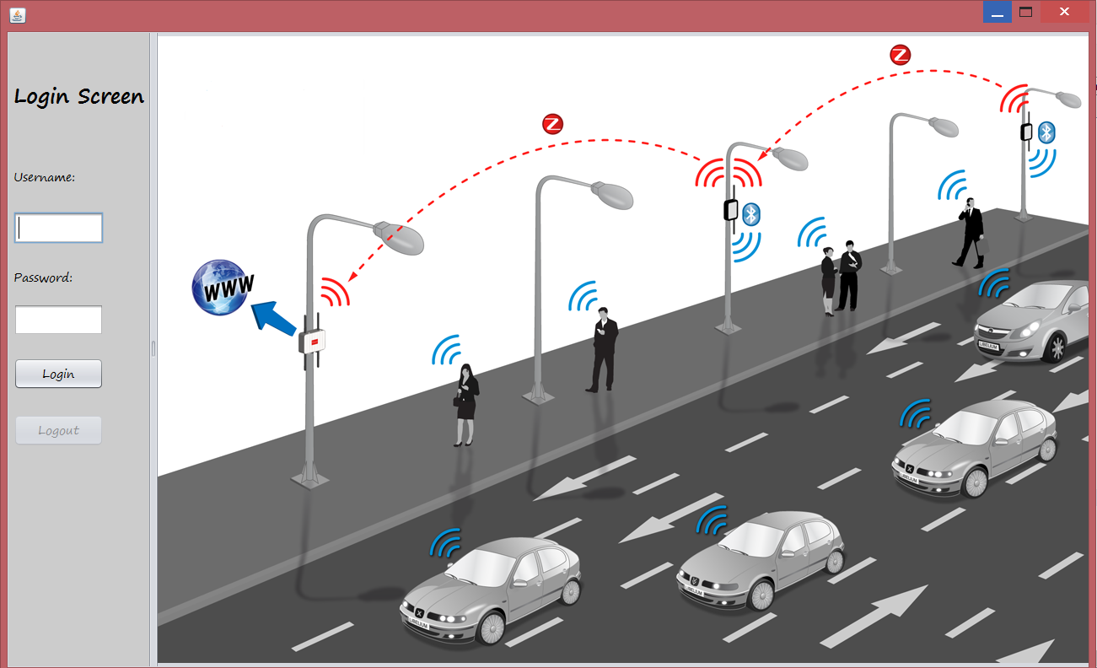
Login Screen to SmartRoad Sensors

Slide 9
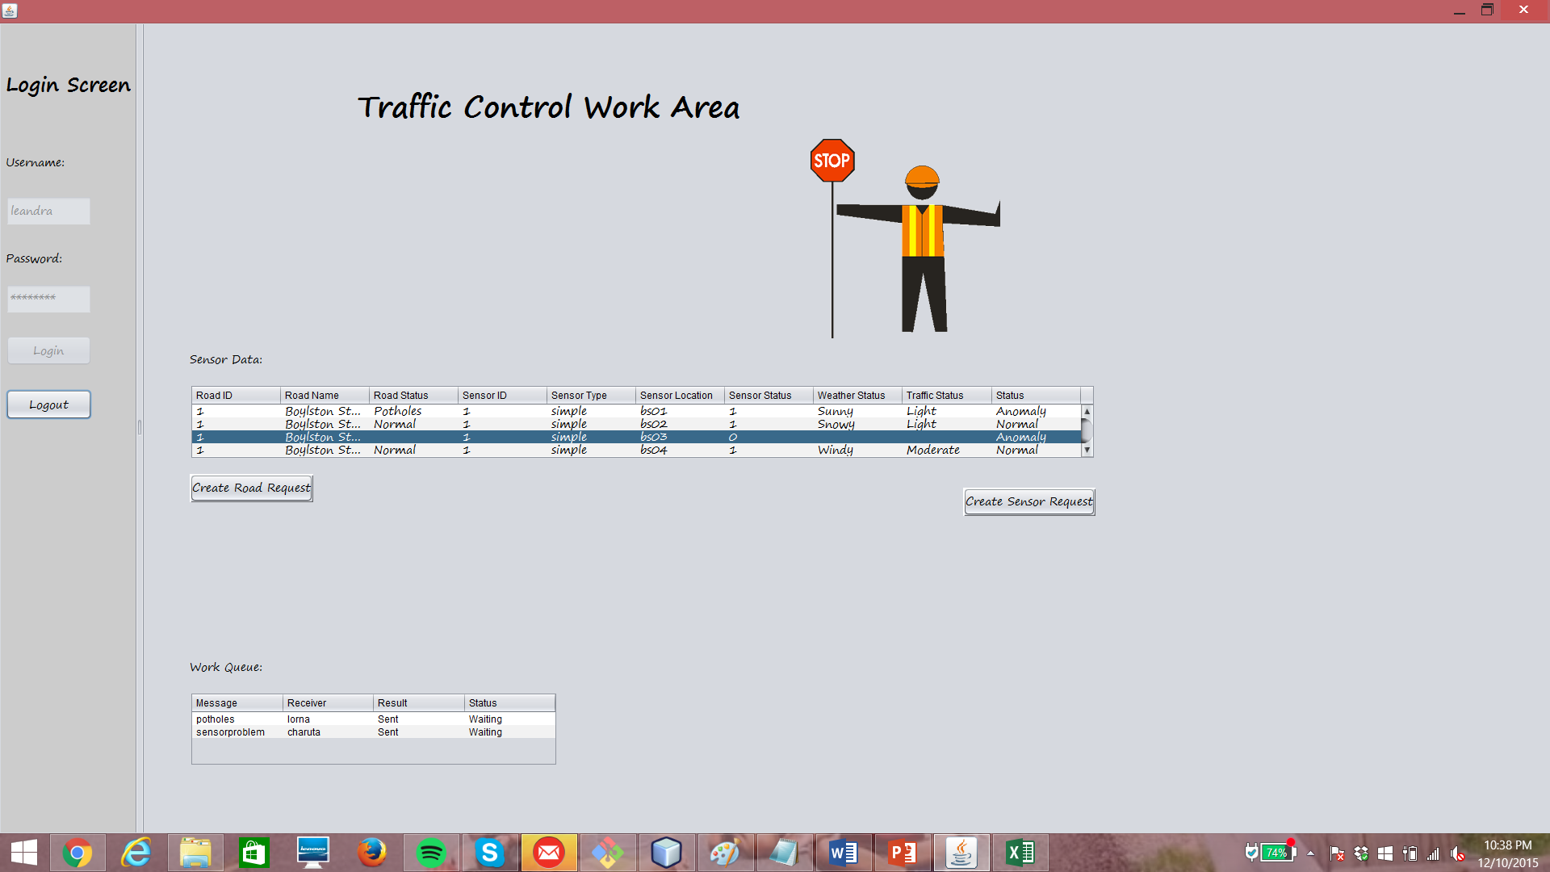
Sensor Anomaly
When the sensor status is 0, it means sensor is not functioning

Slide 10
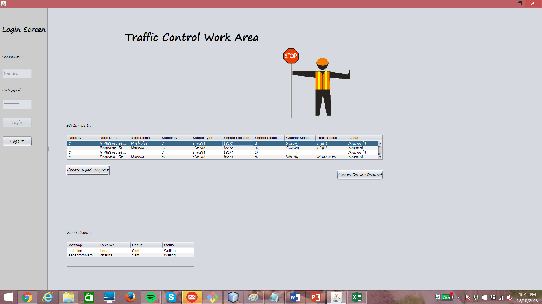
Products From Road Supplier
When there are potholes detected on the road

Slide 11

Request Worker to Maintain
When the sensor detects heavy snow or water on the road

Slide 12
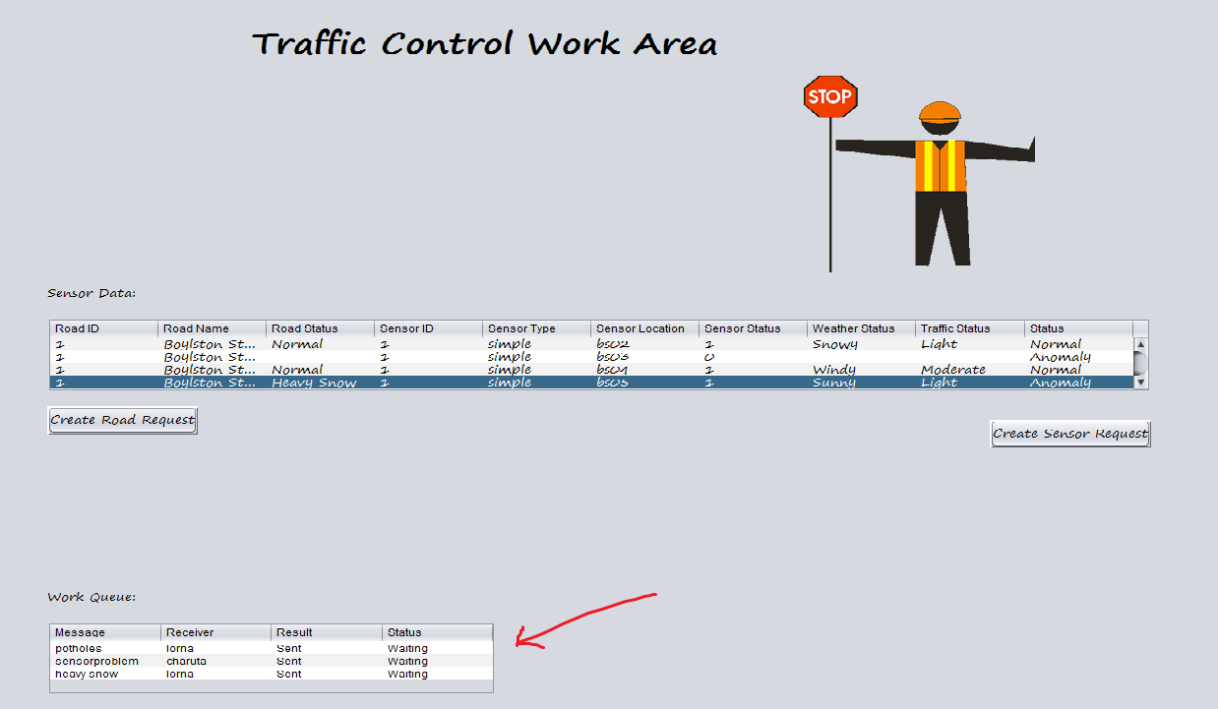
TrafficController WorkQueue
It has all the work requests to send to road maintainer and sensor supplier

Slide 13
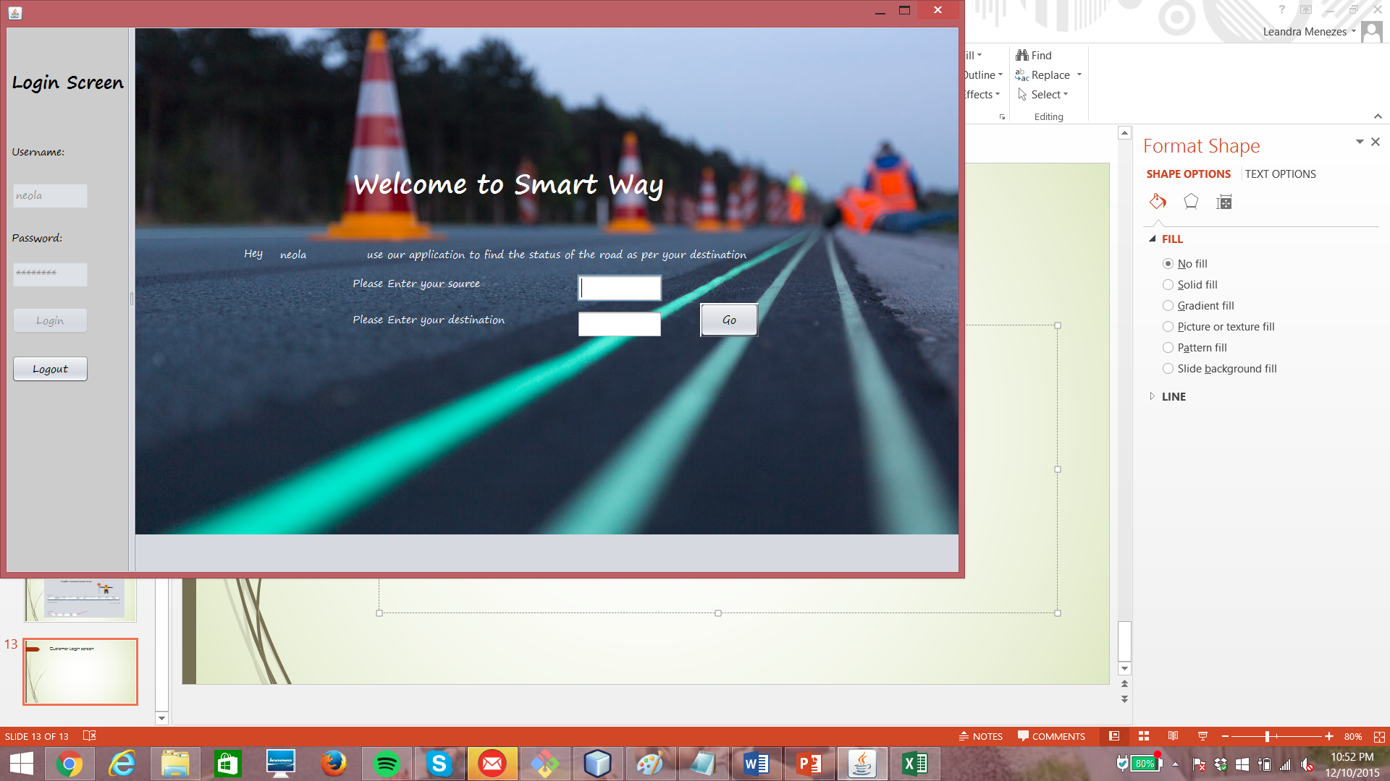
Customer Login screen
Customer enters in source and destination and the gets the road details

Slide 14
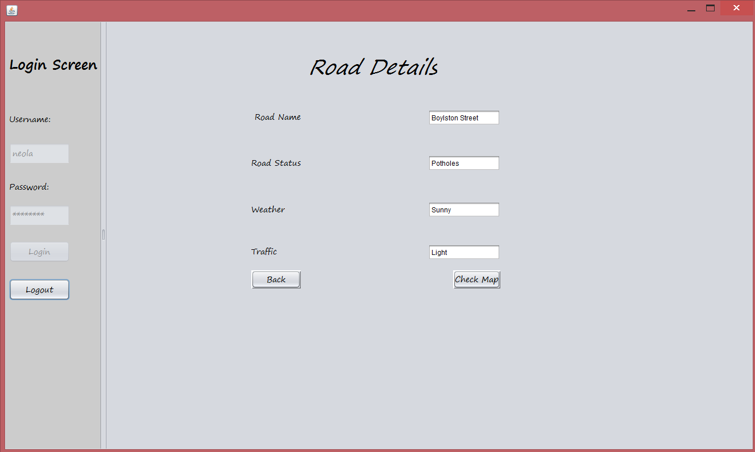
Road Details for Customer
As the customer enters the destination and click Go, he gets the road details

Slide 15
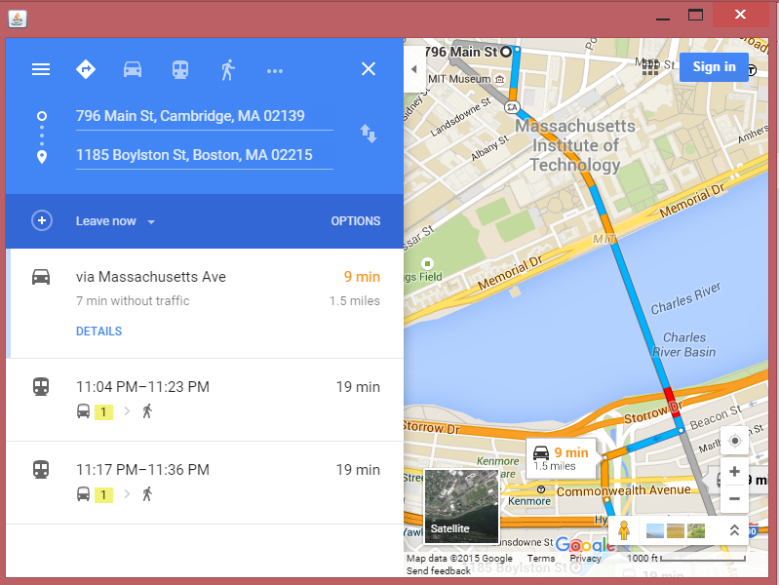
Checking Alternate Route
Customer gets to check google maps and alternate his route

Slide 16
Thank You!

